Slide 1
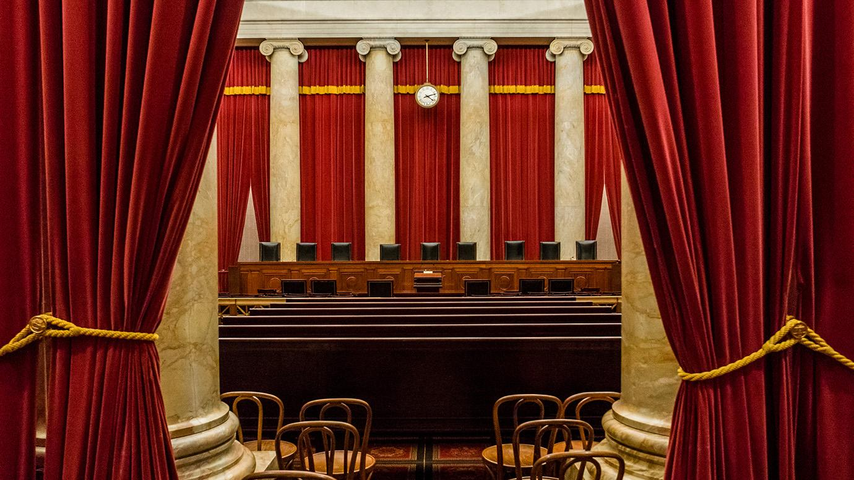
Model Rulings of the United States Supreme Court
Mirella Mardakis, Erica Leon, Emily Tavik

Slide 2
Oyez.
Oyez.
Oyez.
All persons having business before the Honorable, the Supreme Court of the United States, are admonished to draw near and give their attention, for the Court is now sitting. God save the United States and this Honorable Court.

Slide 3
Objectives
Collect data regarding on individual Supreme Court Justice votes
Supreme Court Database (via Washington University Law)
Create a predictive model based on the activity of each Justice in the 2017 term.
Understand and predict how each Justice would vote based on the input data
Use the prediction model to analyze how the 2017 term would have voted on historical cases as well as current cases up before the Court.
Term
Precedent Alteration
Issue Area
Law Type
Case State Origin
Brown v The Board of Education (1954)
Gideon v Wainwright (1963)
Hazelwood v Kuhlmeier
Mapp v Ohio (1961)
Miranda v Arizona (1966)
New Jersey v T.L.O. (1985)
Roe v Wade (1973)
Texas v Johnson (1989)
Regents of the University of California v
Bakke (1978)
Tinker v Des Moines (1969)
US v Nixon (1974)
Flowers v Mississippi (2018)
Washington State Dept. Licensing v
Cougar Den (2018)
Franchise Tax Board California v Hyatt (2018)
American Legion v
American Humanist Society (2018)
Rucho v Common Cause (2018)
Dawson v Steager (2018)

Slide 4
Method
Programmed in Python using a Jupyter Notebook to clean data, export csv(s) and build/train our machine.
Tableau was used to visualize the full data for the 9 Justices in our model as well as the Court’s full rulings from 1949 – 2017.
In the Machine Learning model, the data was first pre-processed, focusing on the direction of the individual justice's ruling, then the best fitting model (linear SVM) was chosen to fit and train the model using the Sci-Kit Learn library.
An HTML script was written to view the collected information.

Slide 5
Mitigating Factors in Ruling Analysis
Thousands of parties petition the Court each year. Cases need a 4/9 vote to be heard. The Court typically hears oral arguments on about 80 cases.
Often, denying to hear a case implies siding with the lower Court’s ruling. These cases cannot be factored into the model.
Theories of Constitutional Interpretation (often labeled as ‘liberal’ or ‘conservative’)
Originalism
Textualism
Non-Originalist (Living Constitutionalism)
Precedent Alterations
Much of an individual Justice's constitutional interpretation involves a willingness to rule against precedent. This isn’t a factor that can be measured or coded as ‘liberal’ or ‘conservative’.

Slide 6
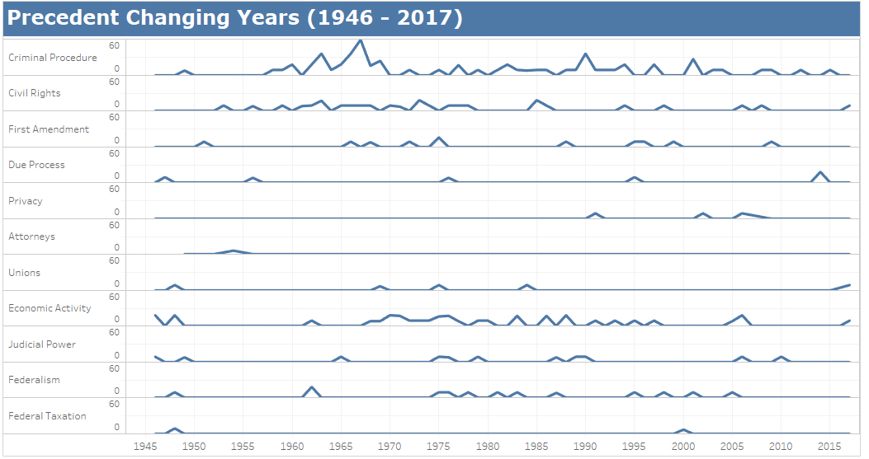
Precedent Changing Years
Criminal Procedure has the highest rate of precedent change and the greatest number of overall precedent changes were enacted in the 1960’s.
All precedent changing votes are trending down over the last 70 years.

Slide 7
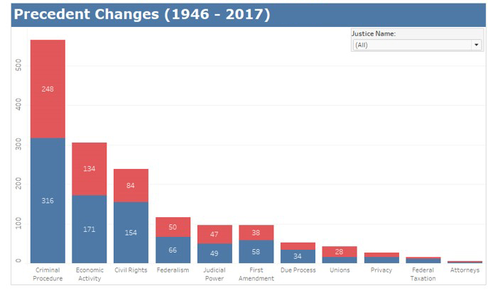
Votes that changed precedents 1949 - 2017

Slide 8
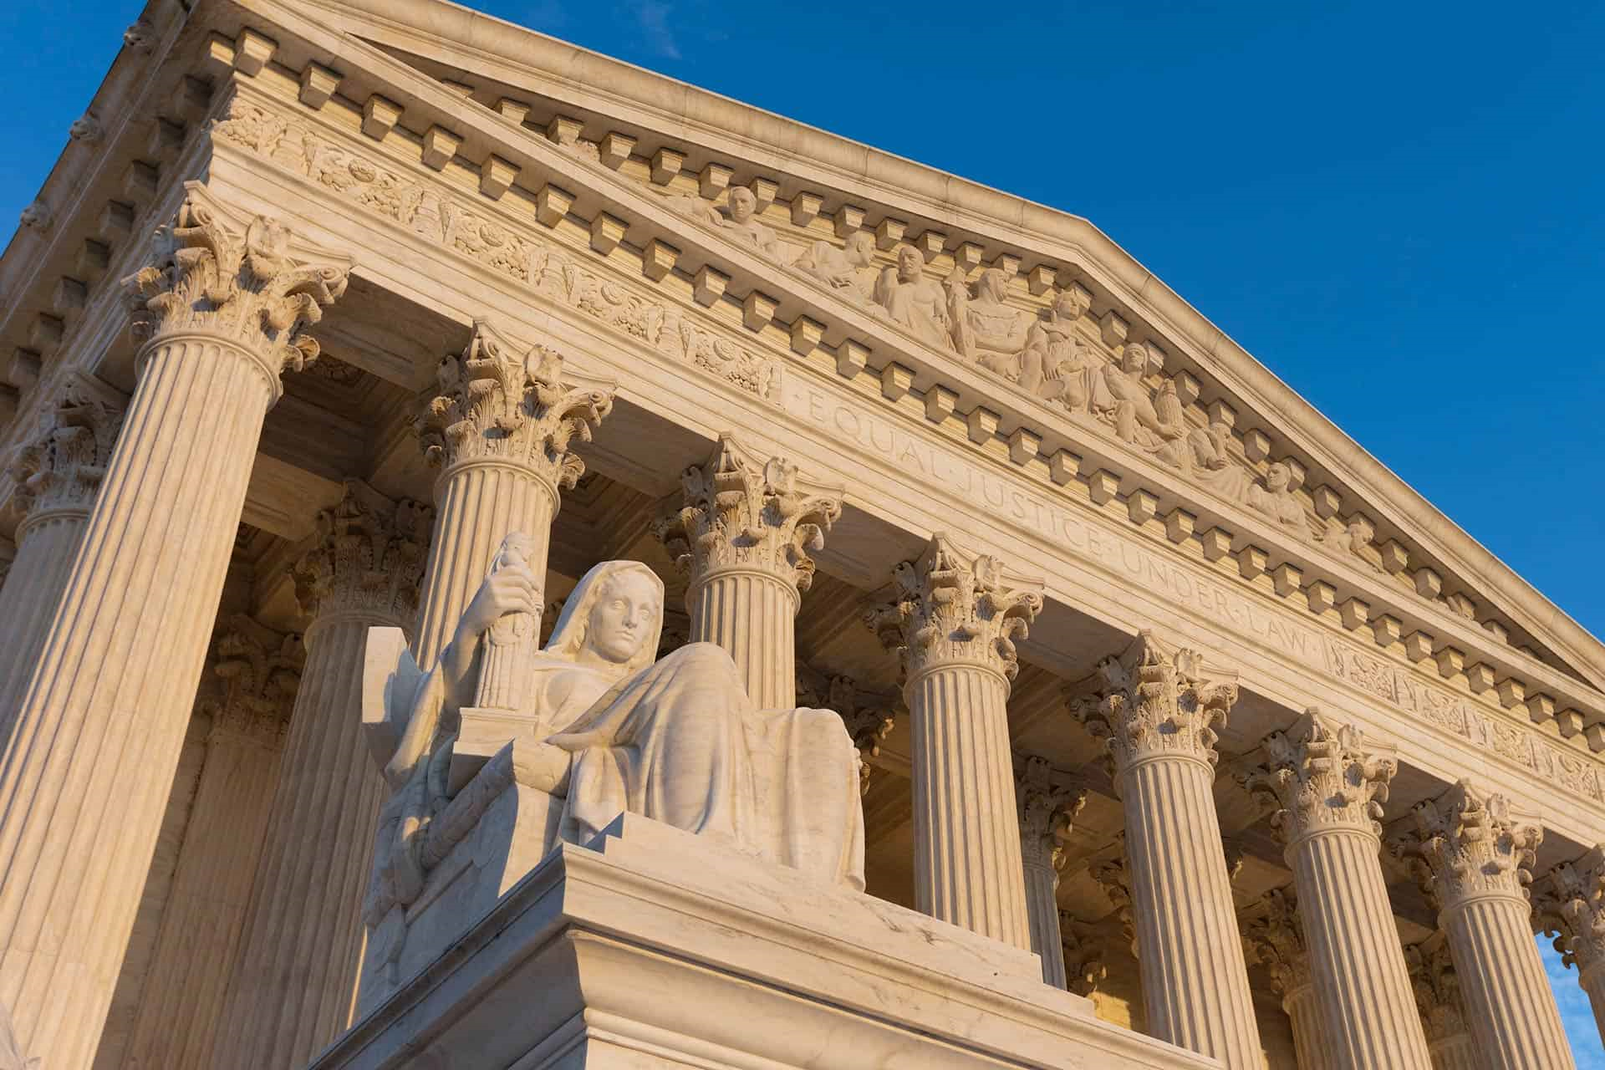
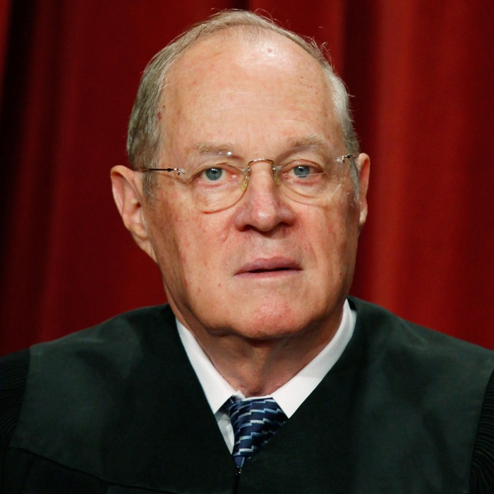
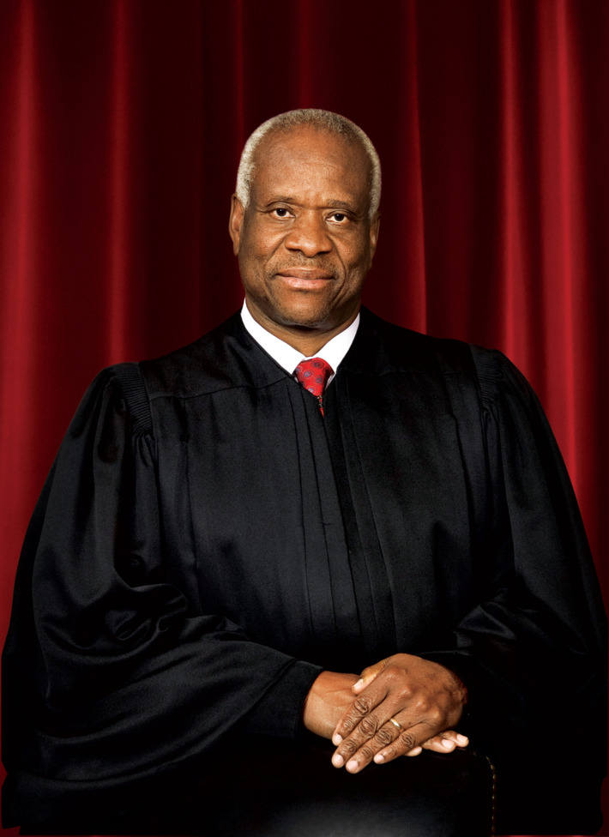
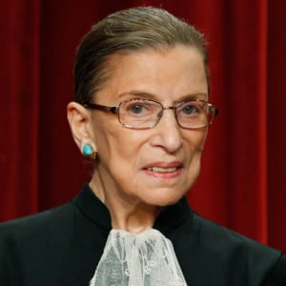
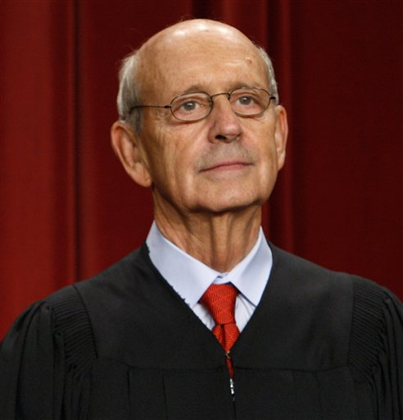
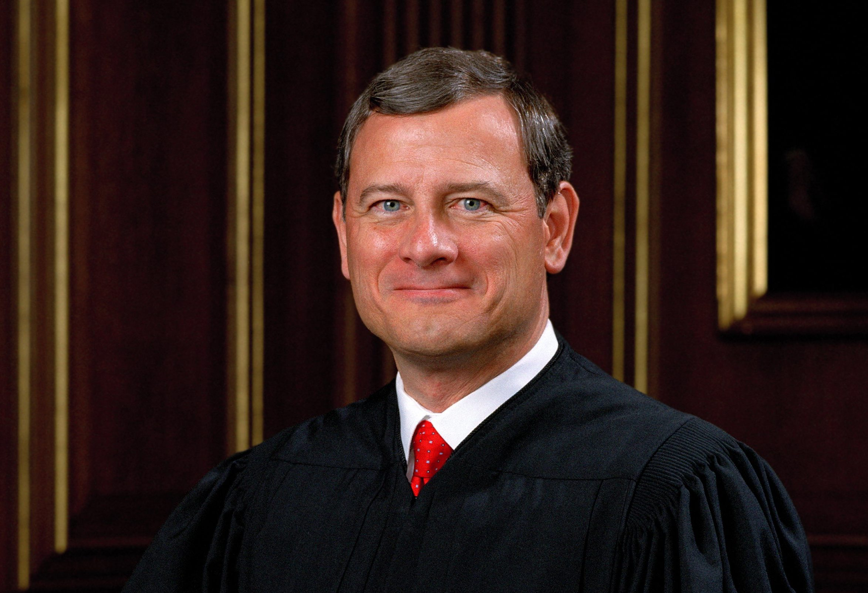
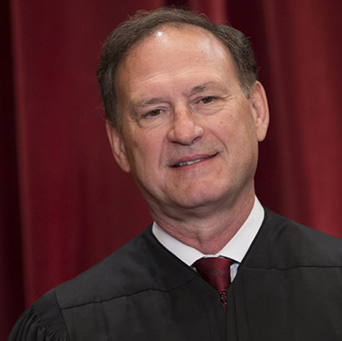
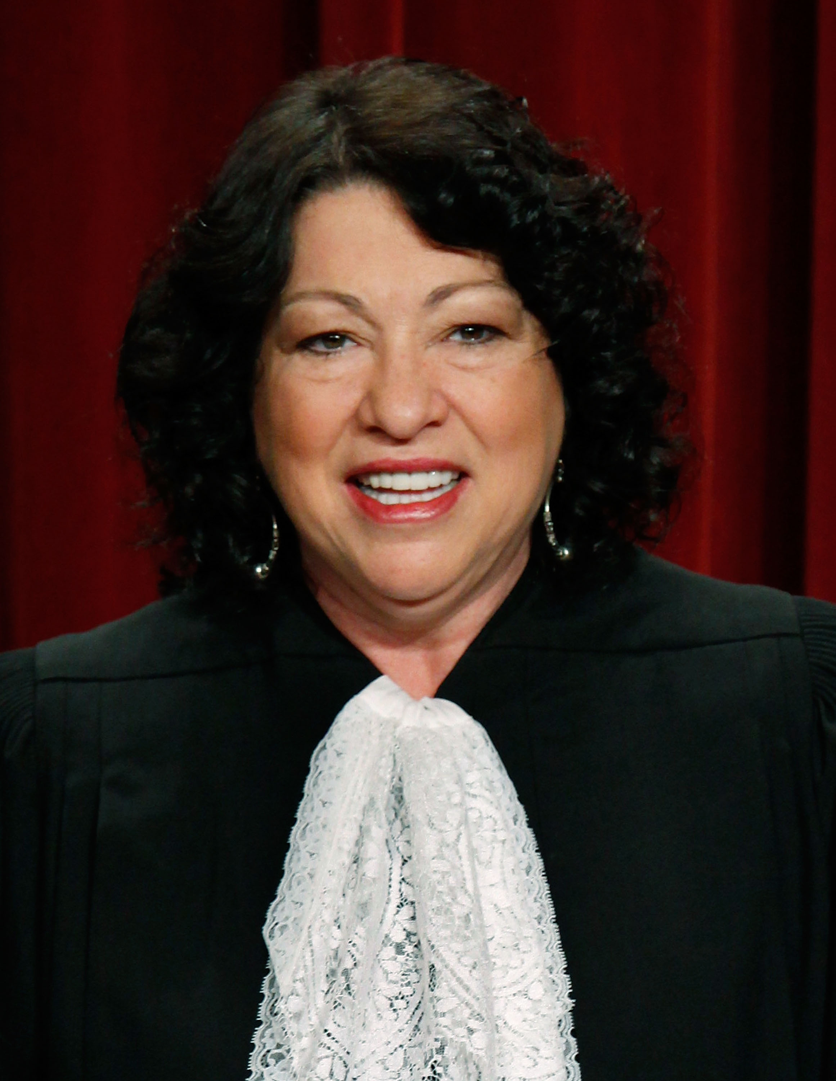
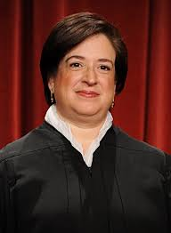
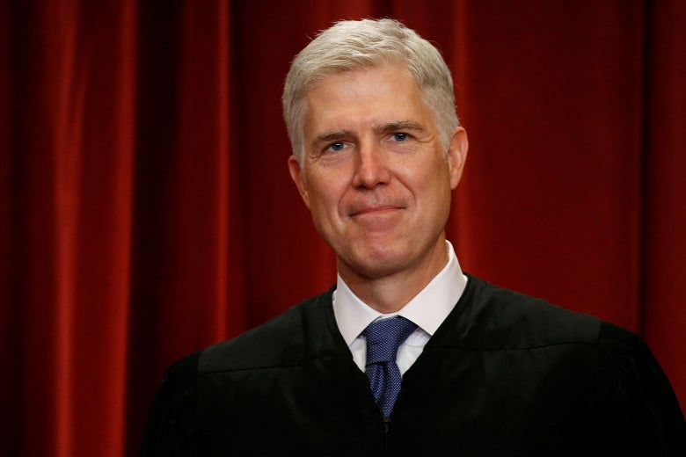
2017 Supreme Court of the United States
EQUAL JUSTICE UNDER LAW
Justice | Appointed | President Nominated | Constitutional Theory
Kennedy | 1987 | Ronald Regan | Non-Originalist
Thomas | 1991 | George H. W. Bush | Originalist
Ginsburg | 1993 | Bill Clinton | Non-Originalist
Breyer | 1994 | Bill Clinton | Non-Originalist
Roberts | 2005 | George W. Bush | Non-Originalist
Alito | 2005 | George W. Bush | Practical Originalist
Sotomayor | 2009 | Barack Obama | Non-Originalist
Kegan | 2010 | Barack Obama | Non-Originalist
Gorsuch | 2017 | Donald Trump | Originalist

Slide 9
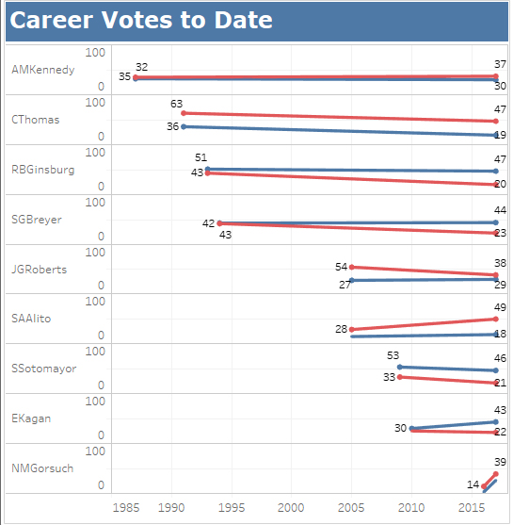
Polarity Over Time
The Justices with the most and least time on the bench (Kennedy, Thomas and Gorsuch respectively) have the least amount of deviation in their vote direction.
Only one Judge (Roberts) has become more centrist during their term.

Slide 10
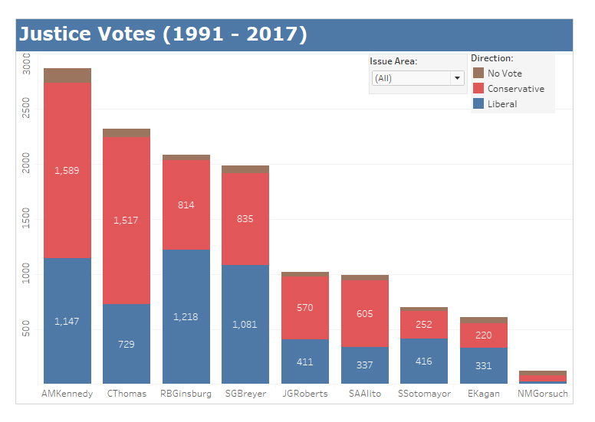
No Vote
Justices may not vote on a case for several reasons, but the most common is recusal.
Justice Kagan’s time as the Solicitor General for President Obama’s Justice Department caused her recuse herself from nearly 40 cases between 2005 - 2015.

Slide 11
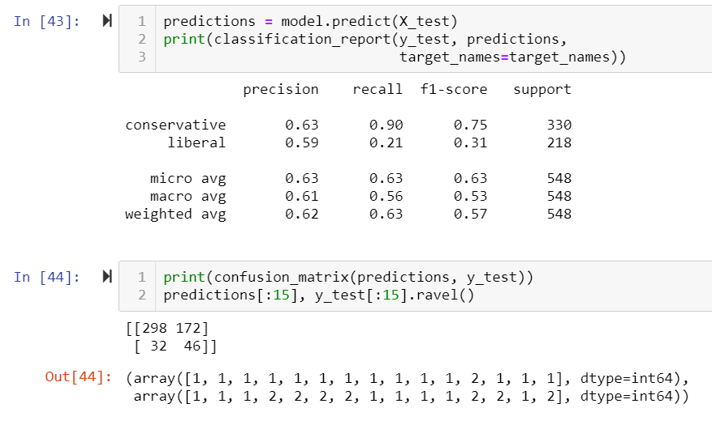
Confusion Matrix compared the true and false negatives and positives to the data.

Slide 12
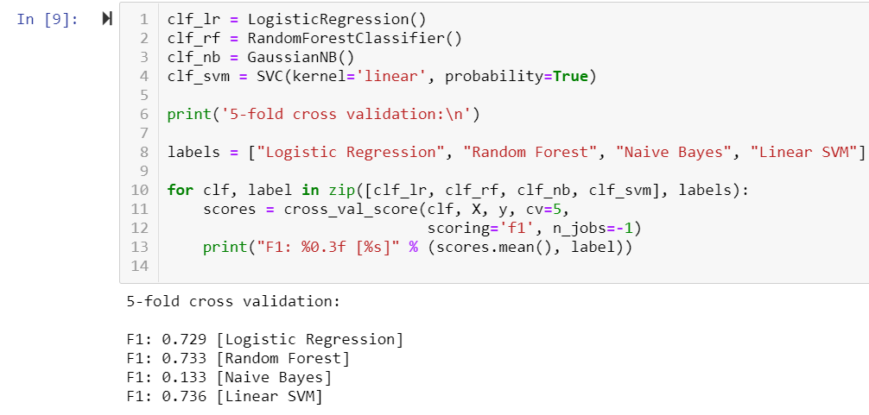
Cross Validation helped us select Linear SVM as our model type.

Slide 13
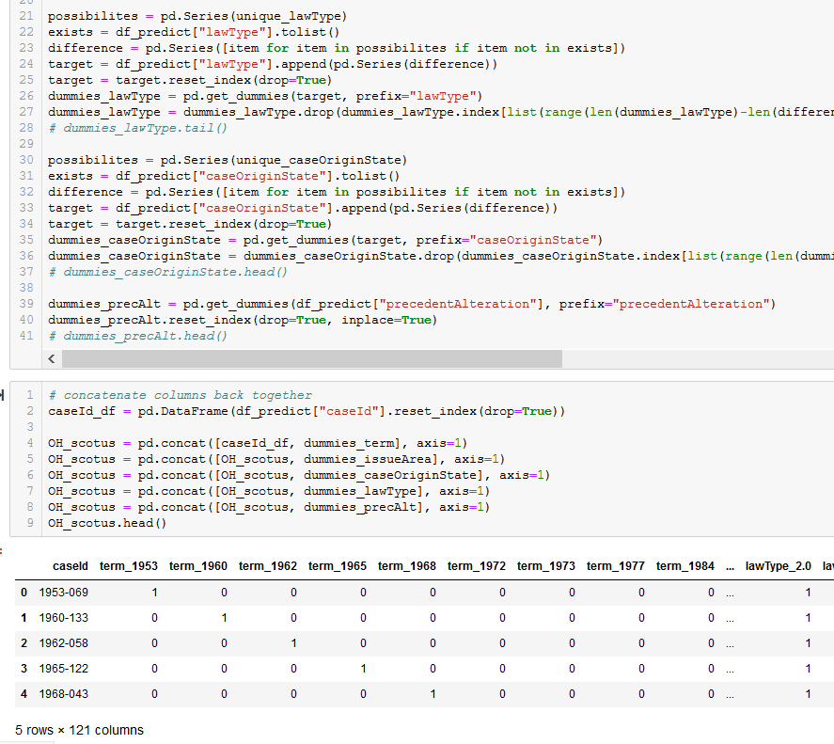
One-Hot Encoding converted the categorical values for the model to use.

Slide 14
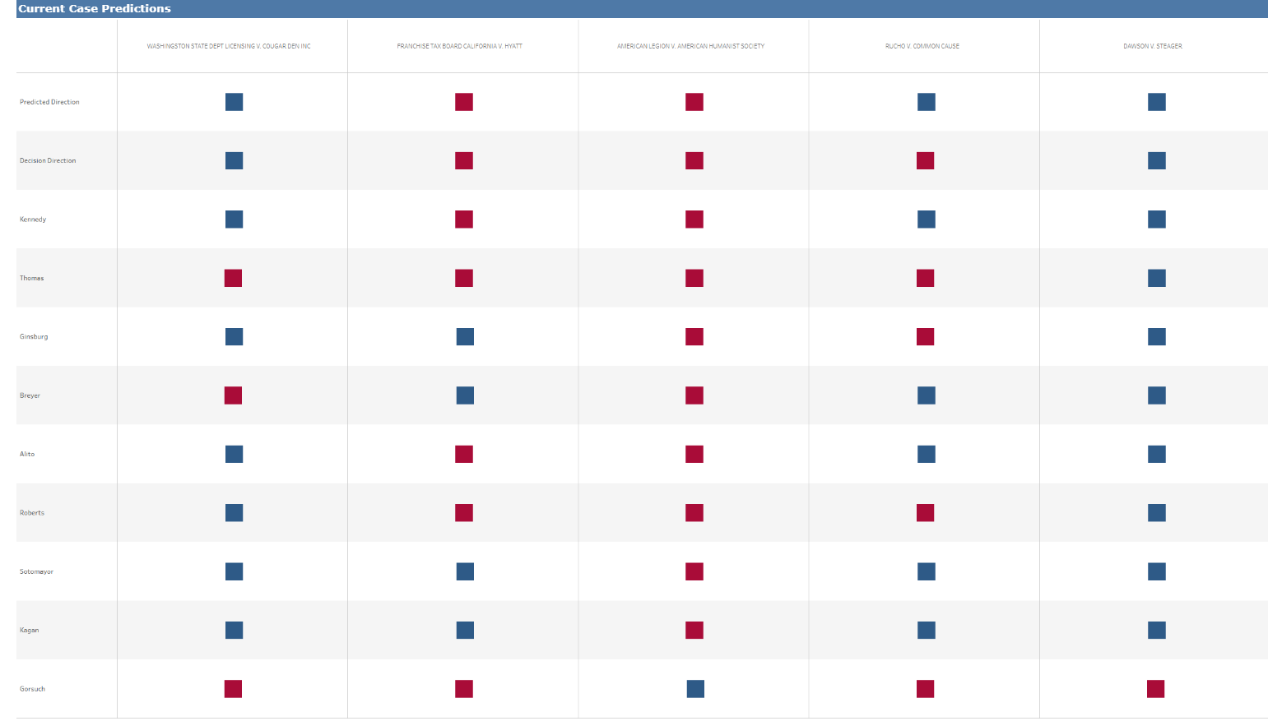
Interestingly, we were able to accurately predict 80% of the cases from the 2018 session, whereas the predicted outcomes for historical cases were not as accurate (25%). This makes sense given that we were making predictions based on different justices than those that were on the court at the time; in addition, conservative and liberal judgement ideologies have experienced significant shifts between when these cases were heard and today.

Slide 15
THANK
YOU

